Slide 1
http://www.uwo.ca/research/51_firsts/
Recently 2015 July; Western University has featured a list entitled 51 Firsts - Research Western - Research Western - .
http://www.uwo.ca/research/51_firsts/I
I am very humbled that I am with researchers I idealized like Sir Fredrick Banting discoverer of Insulin and Nobel prize winner and he is listed #1on the list and #2 person on the list is my former professor and later on a colleague Dr. Murray Barr he is the discoverer of the Barr body (Sex Chromatin) . .I am #17 on the list quoted as follows
. . “During the 1980s, a team led by Khadry Galil promoted, advanced and expanded a surgical glue from a liquid derivative of cyanoacrylate now used worldwide for everything from emergency medicine and blocking aneurysms, to clamping large blood vessels and periodontology”

Slide 2
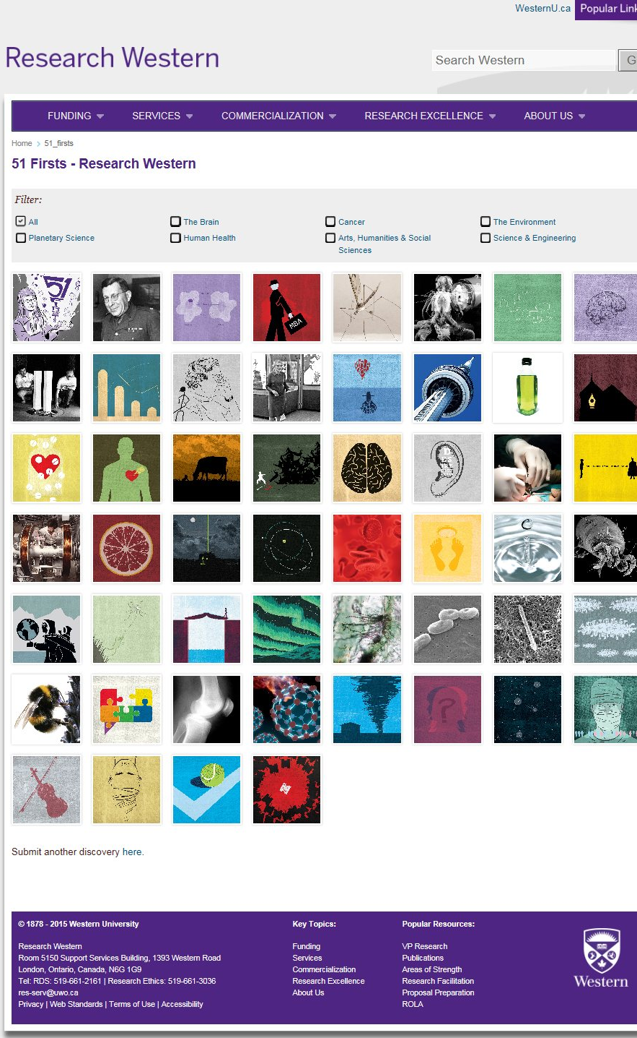

Slide 3
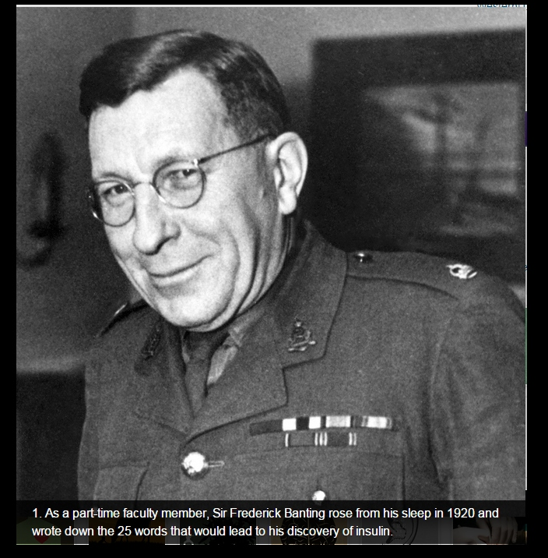

Slide 4
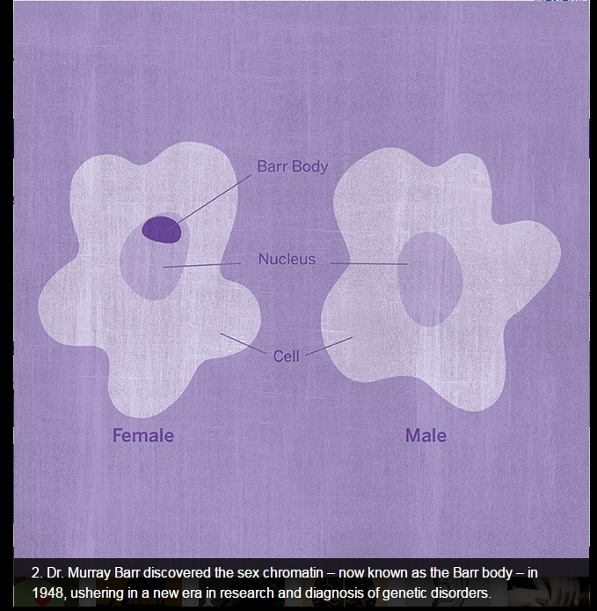

Slide 5
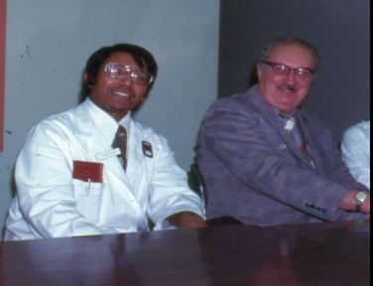
dr Barr and Dr galil1.jpg

Slide 6
